Slide 1
Climate Change Visualizations
By: Radhika Laddha

Slide 2
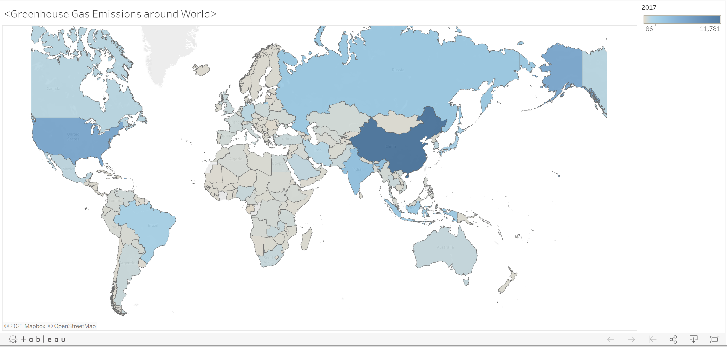

Slide 3
1st Visualization: World Map of all Countries GHG Emissions in 2017
This world map shows all the current GHG emissions by country in 2017. From the map, I can make out that China, Russia, Canada, Brazil, Argentina, India and the U.S. are the seven countries that emit a ton of GHG emissions into the world in comparison to other countries (they are shaded in as medium blue, blue and dark blue). This portrays a message that they need to start taking action now before it becomes worse and they should learn from other countries/adopt their practices who’s GHG emissions aren’t as high (indicated by the gray/faint blue color).

Slide 4
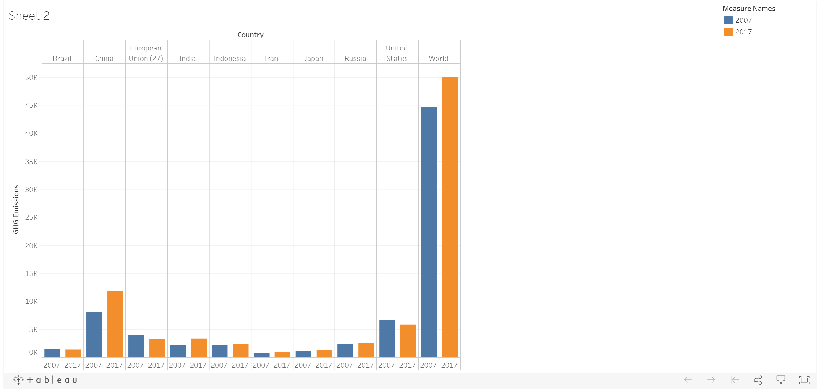

Slide 5
2nd Visualization: Side by Side Bar Chart of Top 10 Countries that Emit GHG Emissions (2007 vs 2017)
This side by side bar chart shows the top 10 countries in the world that emit the most GHG emissions and shows how much their GHG emissions have increased or decreased from 2007 (blue) – 2017 (orange). In addition, the side by side bar chart shows how good the world is doing by displaying total GHG emissions in 2007 total GHG emissions in 2017
From the plot, I can make out that most of the countries are doing fairly well in keeping their GHG emissions down in comparison to China (whose levels have risen up about 3000 in the last years) and if we want to be critical, India too! The thing that scares me the most is that the World is doing so poorly trying to reduce their GHG emissions; to the point where it went from about 45,000 in 2007 to around 50,000 in 2017! This indicates that the world (all countries collectively) have to take immediate action now if they want this trend to change and decrease.

Slide 6
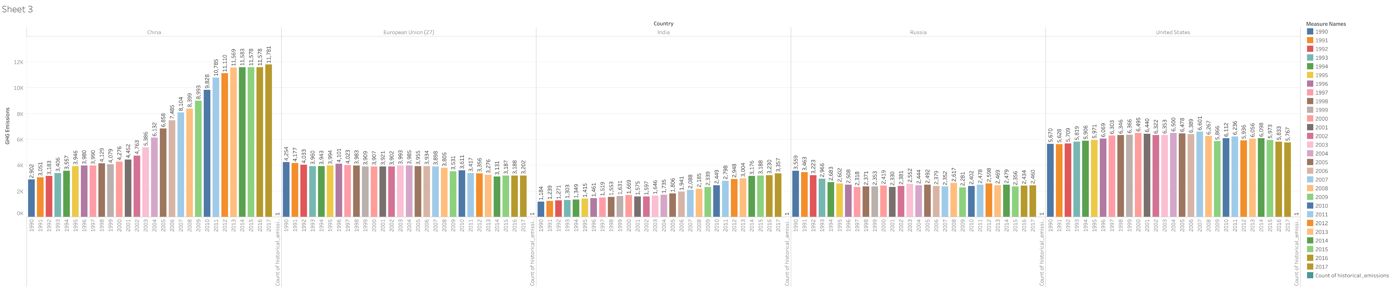

Slide 7
3rd Visualization: GHG Emissions from 1990-2017 of Top 5 Countries
This side by side bar chart shows GHG emissions of Top 5 Countries over the span of 27 years. Each year is color coded to make it easier for comparison (if you want to compare levels of that particular year among other countries) and for presentation purposes. From this side by side bar chart, I can make out that the European Union as well as Russia are trying to keep their GHG levels down over the years while China and India are failing to do so over the years. This side by side bar chart shows the top 5 countries in the world that emit the most GHG emissions and shows how much their GHG emissions have increased or decreased from 2007-2017. In addition, the side by side bar chart shows how good the world is doing by displaying total GHG emissions in 2007 total GHG emissions in 2017. Even though the United States is trying to keep their numbers down and in range, their GHG levels in comparison to Russia and the European Union (especially are about 2000-3000 more higher)! Even though U.S. is trying to keep their levels from not going too high, the main thing they should work on is trying to bring them down significantly first before maintaining the levels.

